Slide 1

Generative Adversarial Network (GAN)
Dr. Amir Yavariabdi
1

Slide 2
Outline
Discriminative Models vs. Generative Models
Introduction to Generative Adversarial Networks (GANs)
Applications of GANs
Key Components of a GAN
Types of Generative Adversarial Networks

Slide 3
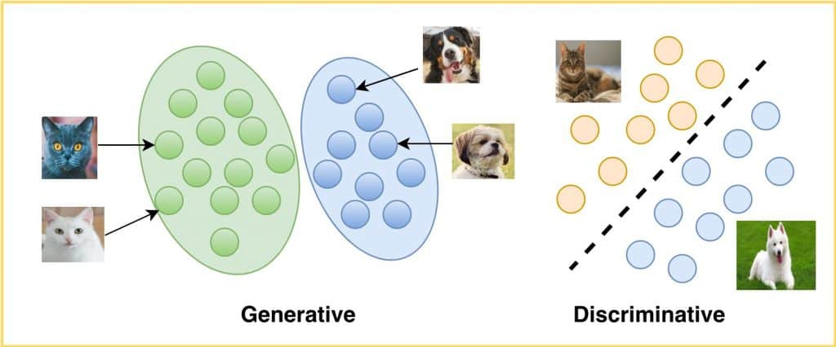
Discriminative Models and Generative Models
Machine learning models can be divided into two groups:
Discriminative models and
Generative models
Find probability distribution
Find decision boundary

Slide 4
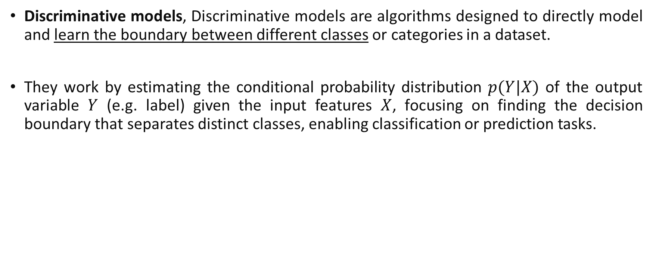
Discriminative Models
Discriminative models, Discriminative models are algorithms designed to directly model and learn the boundary between different classes or categories in a dataset.
They work by estimating the conditional probability distribution $p(Y|X)$ of the output variable $Y$ (e.g. label) given the input features $X$, focusing on finding the decision boundary that separates distinct classes, enabling classification or prediction tasks.
Find decision boundary

Slide 5
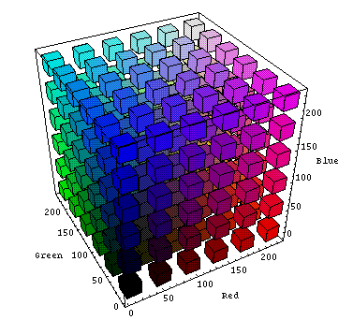
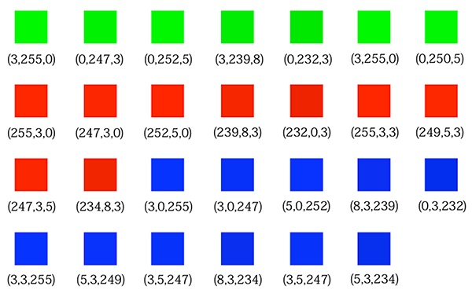
Generative Models
Generative models focus on learning the underlying distribution of the input data to generate new samples that are similar to the training data.
These models focus on understanding how the data is generated.
Find probability distribution
Samples in space
GANs learn the distribution of samples in space

Slide 6
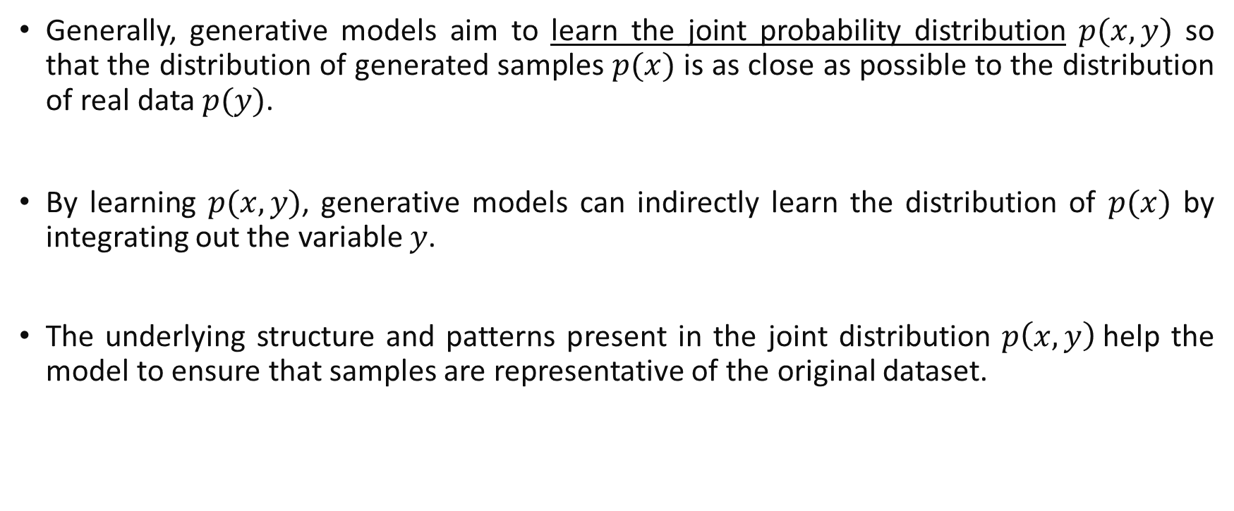
Generative Models
Generally, generative models aim to learn the joint probability distribution $p(x,y)$ so that the distribution of generated samples $p(x)$ is as close as possible to the distribution of real data $p(y)$.
By learning $p(x,y)$, generative models can indirectly learn the distribution of $p(x)$ by integrating out the variable $y$.
The underlying structure and patterns present in the joint distribution $p\left(x,y\right)$help the model to ensure that samples are representative of the original dataset.

Slide 7
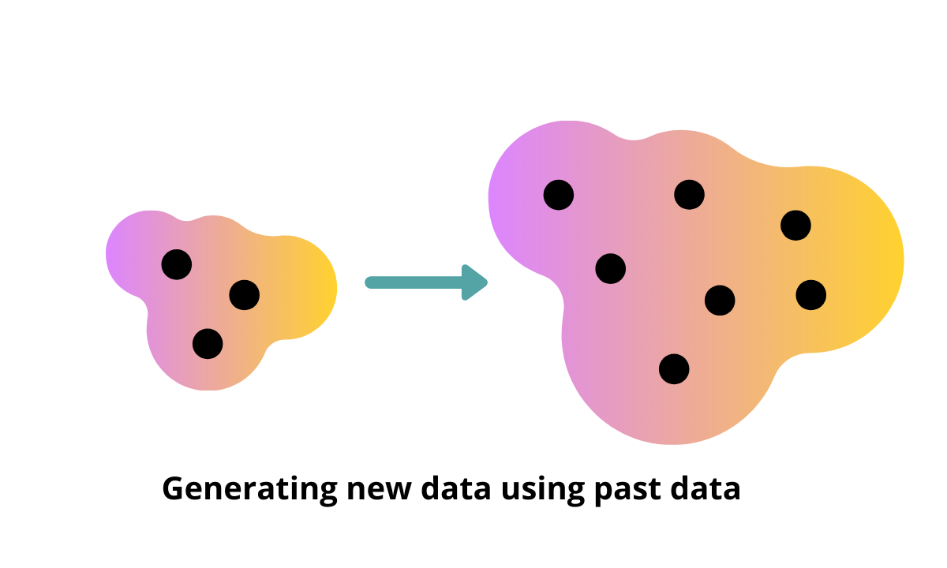
Generative Models
learn the probability distribution of the training data to understand the data’s underlying characteristics.

Slide 8
Generative Models
Generative models generate new data points to be closely similar to the samples in training data with the following considerations:
If a generative model is generating sample data which exactly similar to training data, then these models are memorizing and not useful.
Newly generated data should have diverse samples beyond what we already have in training data.

Slide 9
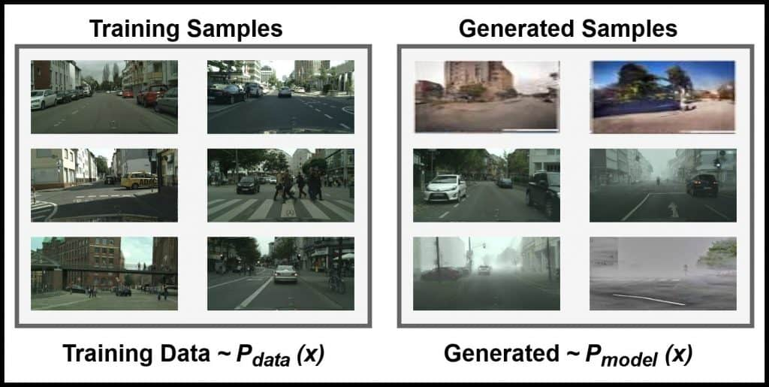
Generative Models: Example
Assume we have an autonomous driving dataset with an urban-scene setting.
We want to generate images from it.
The generated dataset must be semantically and spatially similar to the given dataset.

Slide 10
Generative Models
Assume you have an autonomous driving dataset with an urban-scene setting.
We want to generate images from it.
The generated dataset must be semantically and spatially similar to the given dataset.
To do this, the generative model must understand the data’s underlying structure and learn the realistic, generalized representation of the dataset, such as:
the sky is blue,
buildings are usually tall, and
pedestrians use sidewalks.

Slide 11
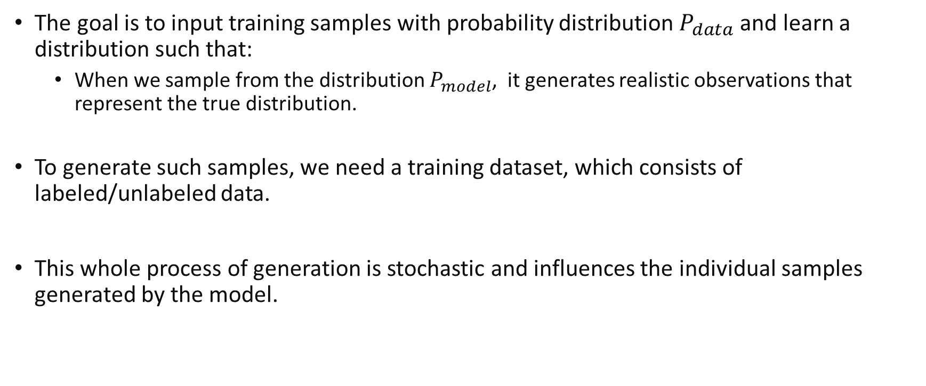
Generative Models
The goal is to input training samples with probability distribution $P_{data}$and learn a distribution such that:
When we sample from the distribution $P_{model}$, it generates realistic observations that represent the true distribution.
To generate such samples, we need a training dataset, which consists of labeled/unlabeled data.
This whole process of generation is stochastic and influences the individual samples generated by the model.
Notes:
A stochastic process is simply a collection of random variables indexed by time
having a random probability distribution or pattern that may be analysed statistically but may not be predicted precisely.

Slide 12
Generative Models
Types of generative models:
Markov Models
Autoregressive Models
Restricted Boltzmann Machines
Autoencoder (e.g. Variational Autoencoders)
Generative Adversarial Networks (GANs)

Slide 13
Generative Adversarial Networks (GANs)
GAN is a deep learning architecture introduced by Ian Goodfellow in 2014.
It trains two neural networks to compete against each other to generate more realistic new data from a given training dataset.
For instance, you can generate new images from an existing image database or
you can generate original music from a database of songs.
A GAN is called adversarial because it trains two different networks and pits them against each other.
GANs are primarily used for generative modeling and unlike traditional models that rely on explicit rules or probabilities, GANs learn to generate data through a competitive learning process.

Slide 14
Generative Adversarial Networks (GANs)
A GAN consists of two neural networks that train together.
One network generates new data by taking an input data sample (e.g. random variable) and modifying it as much as possible to resembling the real samples.
The other network tries to predict whether the generated data output belongs to the real (original) dataset.
The predicting network determines whether the generated data is fake or real.
At each epoch, the system generates newer values, improved versions of fake data, until the predicting network can no longer distinguish fake from original.

Slide 15




Applications of GANs
The GAN architecture has several applications across different industries.
Generate images
Generative adversarial networks create realistic images.
They can create realistic and immersive visual experiences in video games and digital entertainment.
Images are obtained via https://thispersondoesnotexist.com/

Slide 16
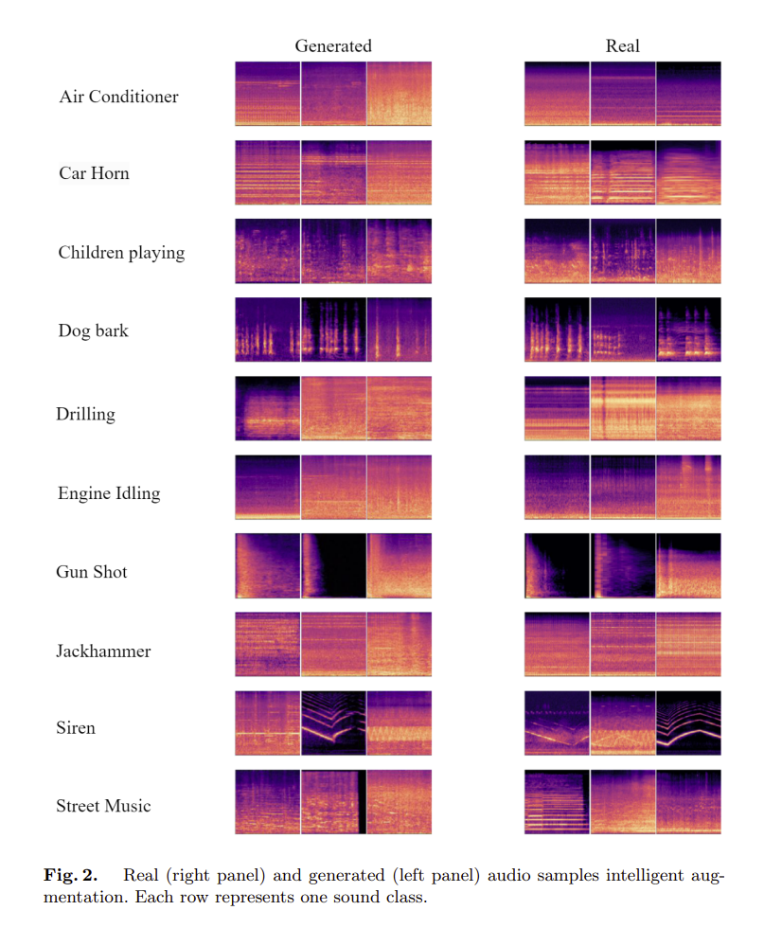
Applications of GANs
Generate training data for other models
GAN artificially increases the training set by creating modified copies of a dataset using existing data.
Y. Chen et al., Data Augmentation for Environmental Sound Classification Using Diffusion Probabilistic Model with Top-k Selection Discriminator, 2023

Slide 17
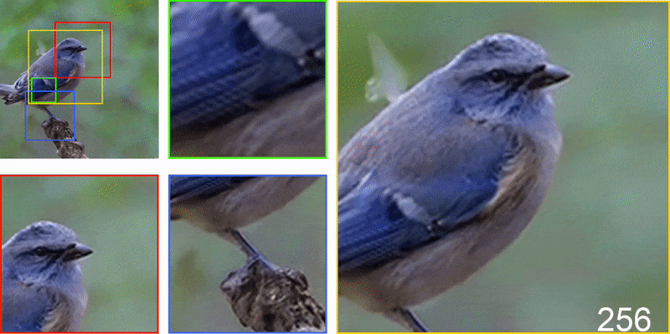
Applications of GANs
Image enhancement
GAN can convert a low-resolution image to a high resolution.
L. Chai et al., Any-resolution Training for High-resolution Image Synthesis, ECCV, 2022

Slide 18
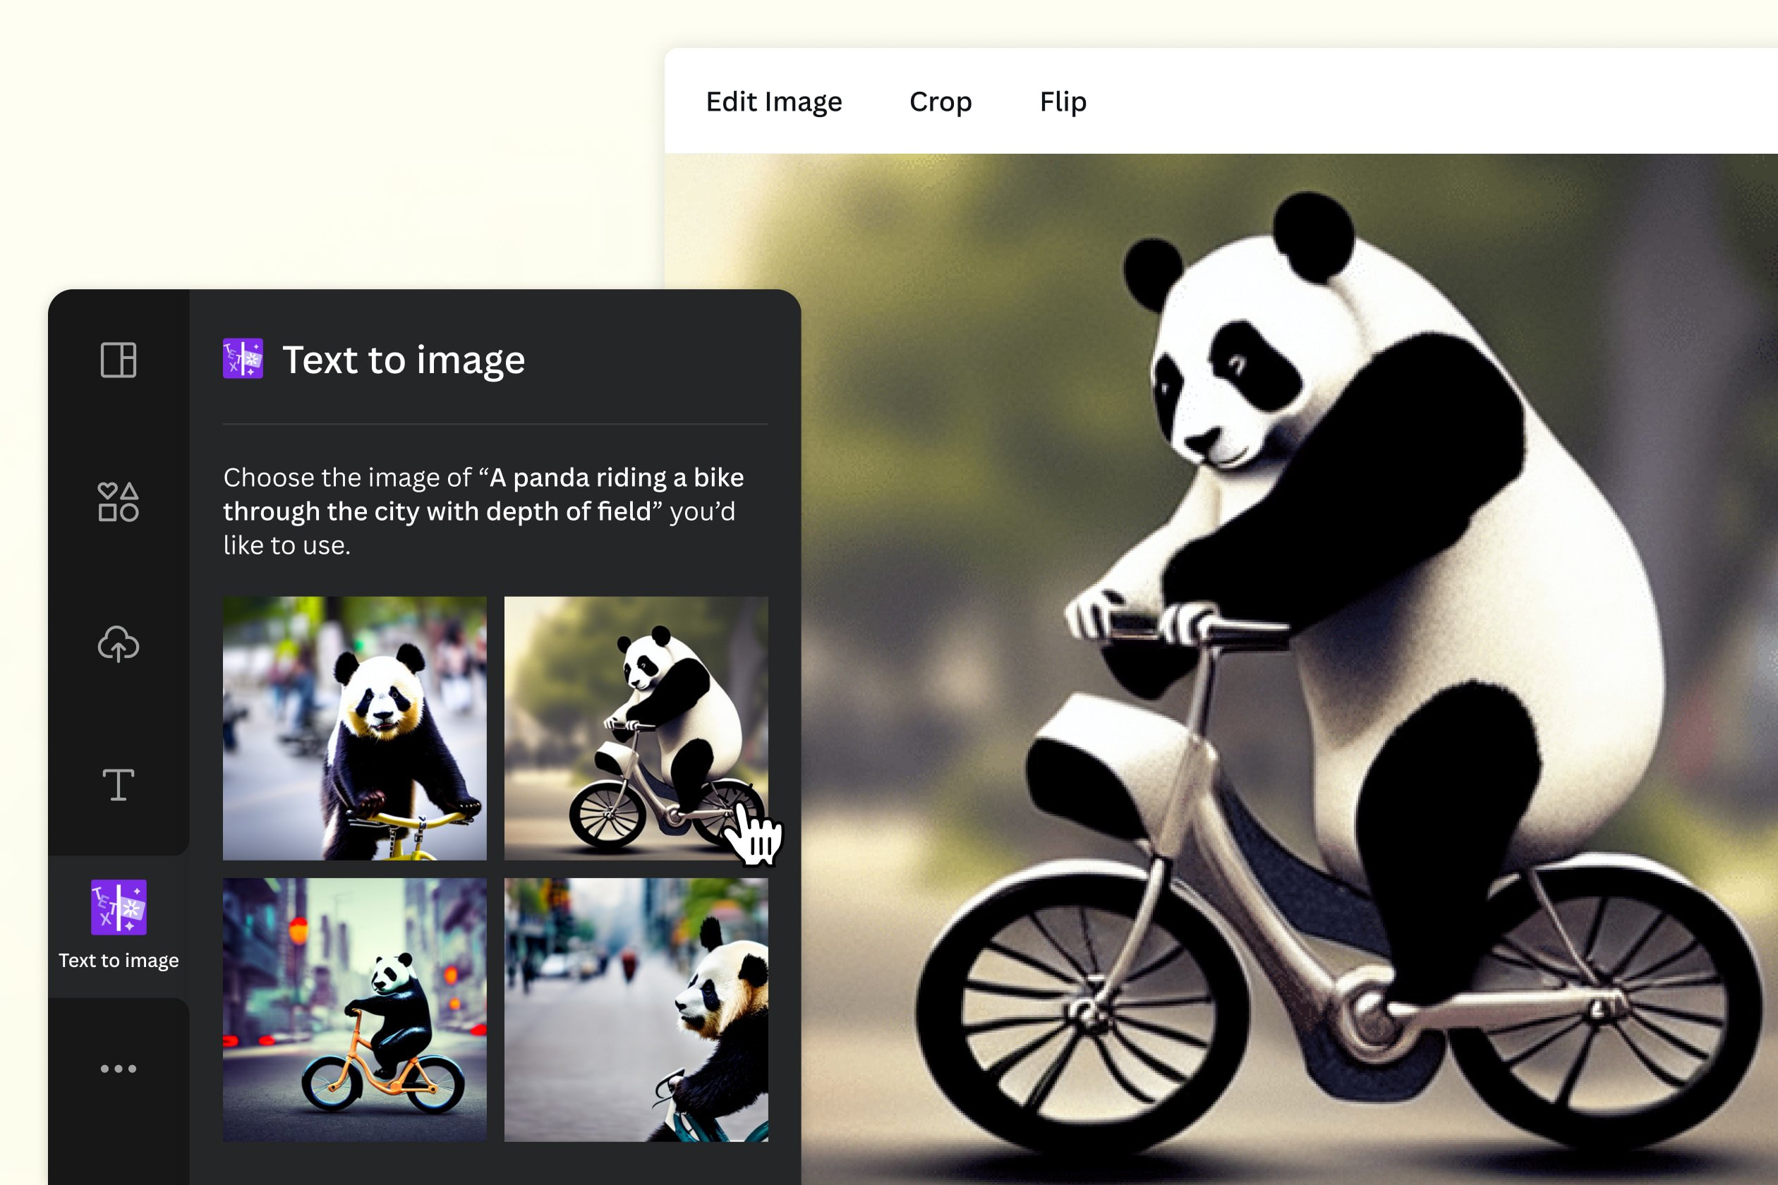
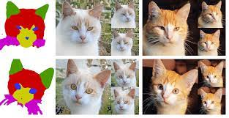
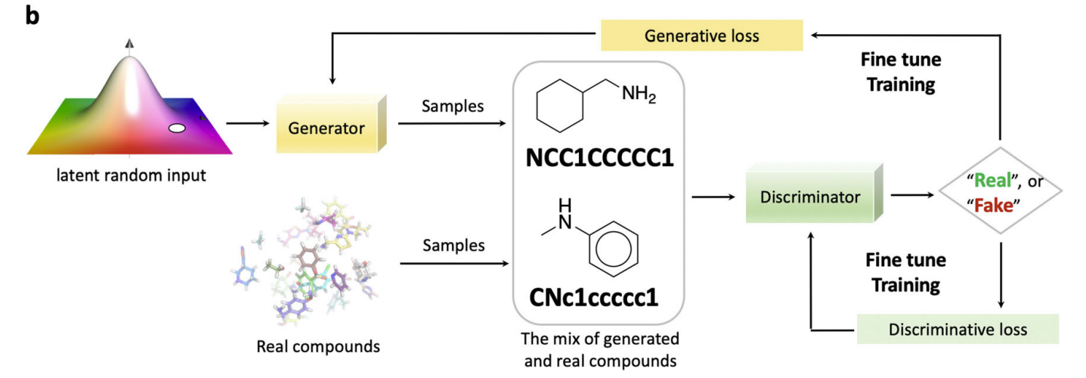
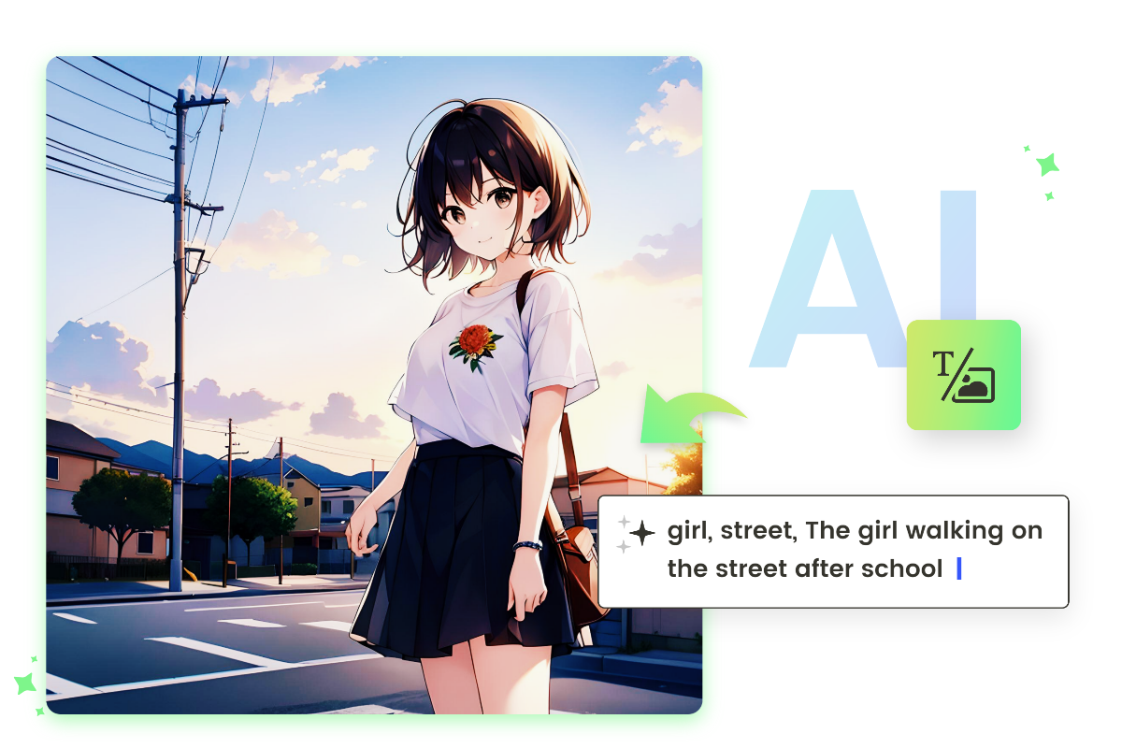
Applications of GANs
Synthesis data generation
Image synthesis is the process of creating new images from some form of image description.
Text to Image
Segment to Image
Molecule Synthesis
AI Comic Generator

Slide 19
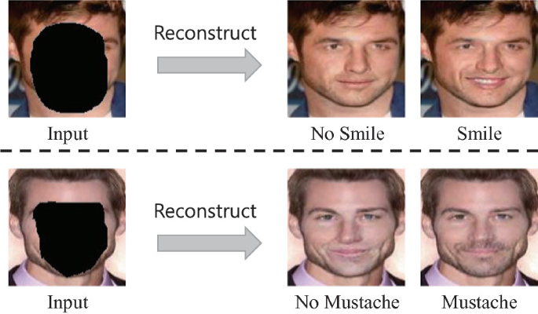
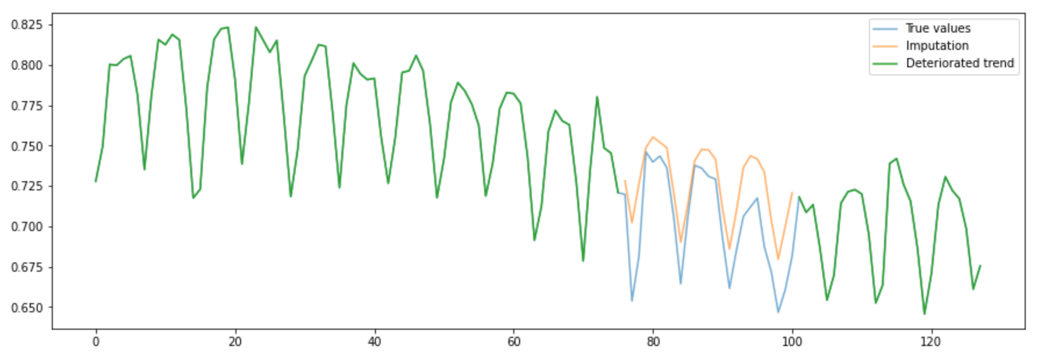
Applications of GANs
Data imputation
It is a method for retaining the majority of the dataset's data and information by substituting missing data with a different value.

Slide 20
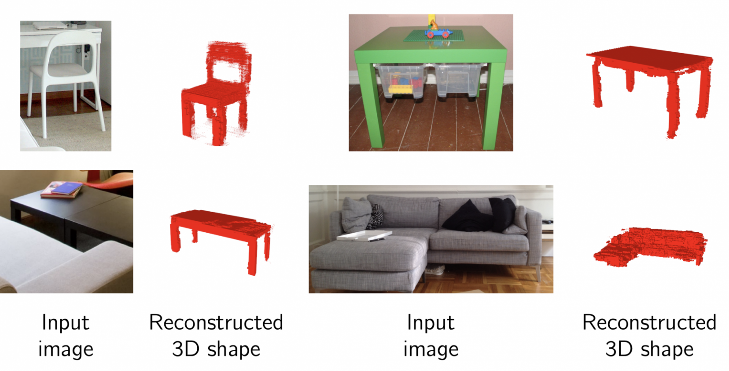
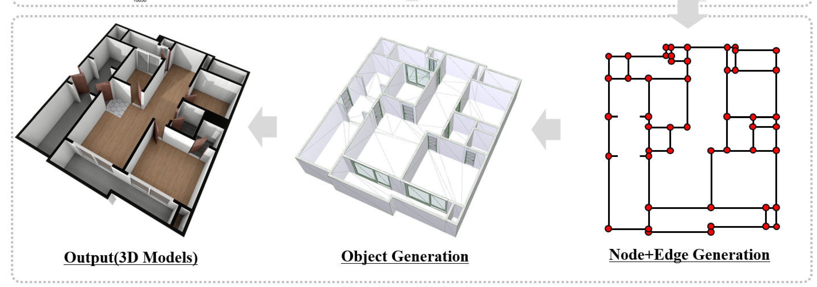
Applications of GANs
Generate 3D models from 2D data
GANs can be trained to generate 3D image data based on a single 2D image.

Slide 21
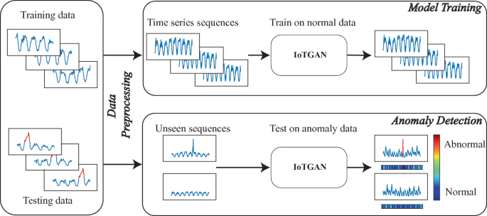
Applications of GANs
Anomaly Detection
GANs can be used to identify rare observations which are suspicious because they differ significantly from standard behaviors or patterns.
X. Chen et al., IoT-GAN: Anomaly Detection for Time Series in IoT Based on Generative Adversarial Networks, 2022.

Slide 22
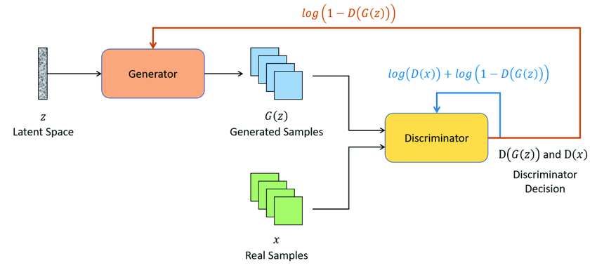
Generative Adversarial Networks: Components
GANs consists of two neural networks:
Generator
Discriminator
Generator Loss
Discriminator Loss
Random Sample

Slide 23
Generative Adversarial Networks: Generator
Purpose: The generator is designed to create samples that closely resemble real data.
Input: It takes a random vector, typically drawn from a Gaussian distribution, as input.
Latent Space: It is a conceptual space that generator learns to represent the essential features and patterns of the data.
The latent space serves as a projection or compression of the observed raw data distribution, capturing high-level concepts and meaningful representations.
In this space, each point corresponds to a unique configuration of latent variables, influencing the generation of diverse and realistic data samples by the generator.

Slide 24
Generative Adversarial Networks: Generator
Purpose: The generator is designed to create samples that closely resemble real data.
Input: It takes a random vector, typically drawn from a Gaussian distribution, as input.
Latent Space: It is a conceptual space that generator learns to represent the essential features and patterns of the data.
Training: During training, the generator learns to apply meaning to points in the latent space, enabling it to generate diverse and realistic outputs based on the input vectors.
Output Generation: After training, the generator model is utilized to generate new samples by providing points from the latent space as input.
These new samples exhibit characteristics similar to those seen in the training data, demonstrating the generator's ability to produce diverse and realistic outputs.

Slide 25
Generative Adversarial Networks: Discriminator
Purpose: The discriminator distinguishes between real and generated data samples
Input: The input to the discriminator consists of both real data samples from the training dataset and fake data samples generated by the generator.
Real Data Input: These are actual data instances from the domain that the discriminator has learned during training.
Fake Data Input: These are synthetic data samples generated by the generator using random input vectors from the latent space.
Functionality: It is a neural network that learns to classify input data as either real (from the training dataset) or fake (generated by the generator).
The discriminator's primary function is to provide feedback to the generator by assessing the realism of the generated samples.

Slide 26
Generative Adversarial Networks: Discriminator
Purpose: The discriminator distinguishes between real and generated data samples
Input: The input to the discriminator consists of both real data samples from the training dataset and fake data samples generated by the generator.
Functionality: It is a neural network that learns to classify input data as either real (from the training dataset) or fake (generated by the generator).
Training: the discriminator is trained using a combination of real and fake data.
It learns to differentiate between these two types of data, optimizing its parameters to improve discrimination accuracy.
Adversarial Training Dynamics: The discriminator engages in an adversarial training process with the generator.
As the generator improves, the discriminator's task becomes more challenging, leading to a competitive learning dynamic between the two networks.

Slide 27
Generative Adversarial Networks: Discriminator
Purpose: The discriminator distinguishes between real and generated data samples
Input: The input to the discriminator consists of both real data samples from the training dataset and fake data samples generated by the generator.
Functionality: It is a neural network that learns to classify input data as either real (from the training dataset) or fake (generated by the generator).
Training: the discriminator is trained using a combination of real and fake data.
Adversarial Training Dynamics: The discriminator engages in an adversarial training process with the generator.
Discriminator Output: A probability score indicating the likelihood that the input data sample is real or fake.
This output guides the training of both the discriminator and the generator, contributing to the adversarial training process.

Slide 28
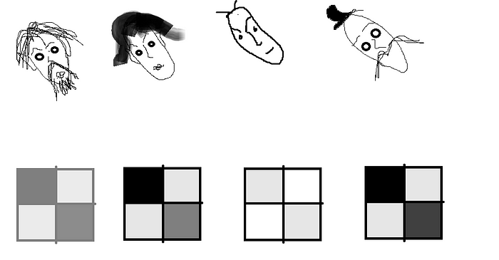
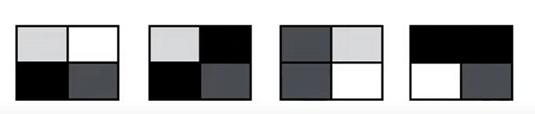
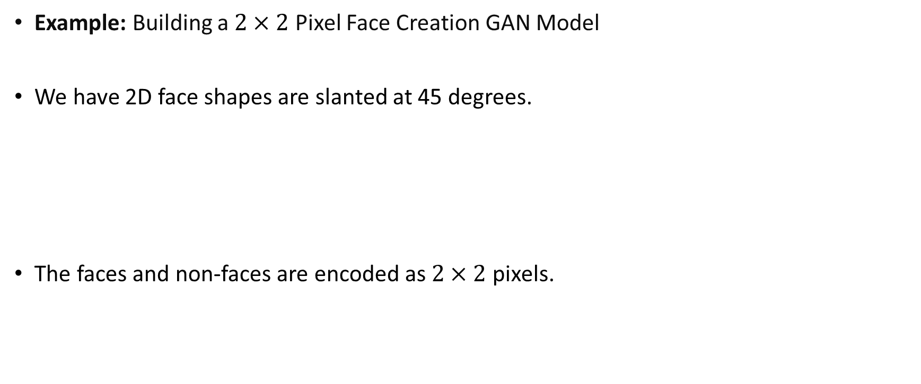
Generative Adversarial Networks: Example
Example: Building a $2×2$ Pixel Face Creation GAN Model
We have 2D face shapes are slanted at 45 degrees.
The faces and non-faces are encoded as $2×2$ pixels.
Encoded Faces
Encoded Non-Faces

Slide 29
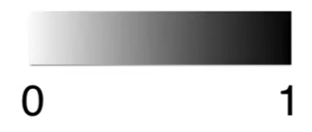
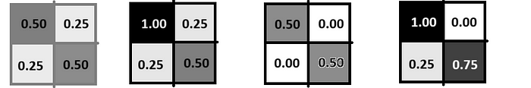
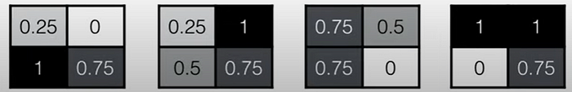
Generative Adversarial Networks: Discriminator
Replace all colors from white to black with numbers between 0 to 1.
Encoded Faces
Encoded Non-Faces

Slide 30
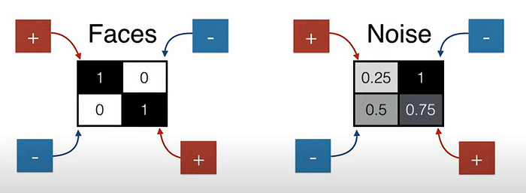
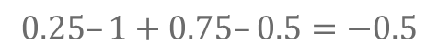
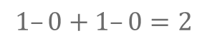
Generative Adversarial Networks: Discriminator
In the faces, the colors on the primary corners are much higher than the colors on the non-primary corners.
In the non-faces, the order of colors can be any regardless of its position.
Therefore, we can add 1st and 4th block’s color number and the other two will be subtracted.
$$1–0+1–0=2$$
Encoded Faces
$$0.25–1+0.75–0.5=−0.5$$
Encoded Non-Faces

Slide 31
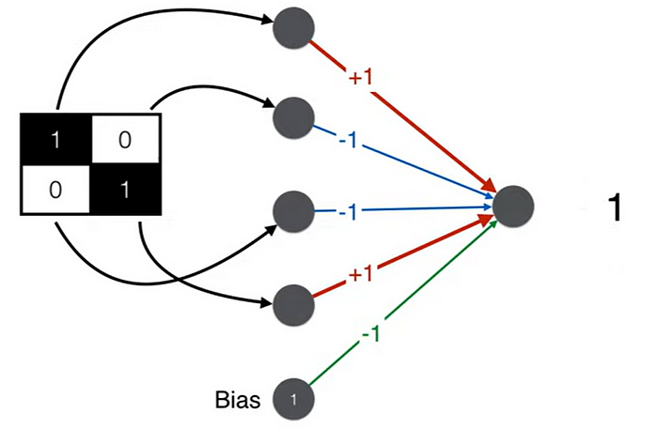
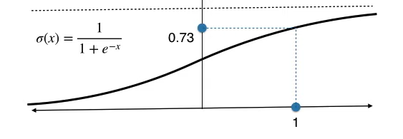
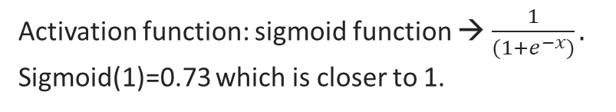
Generative Adversarial Networks: Discriminator
This is a neural network that classify input data.
Activation function: sigmoid function → $\frac{1}{(1+e^{−x})}.$
Sigmoid(1)=0.73 which is closer to 1.
The discriminator identifies it as a face.

Slide 32
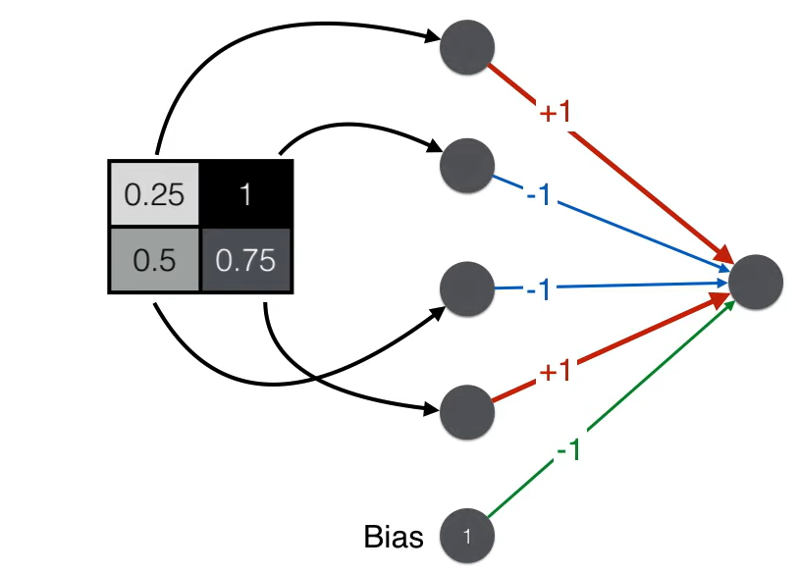
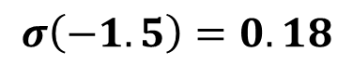
Generative Adversarial Networks: Discriminator
This is a neural network that classify input data.
$$σ\left(−1.5\right)=0.18$$
The discriminator identifies it as a non-face.

Slide 33
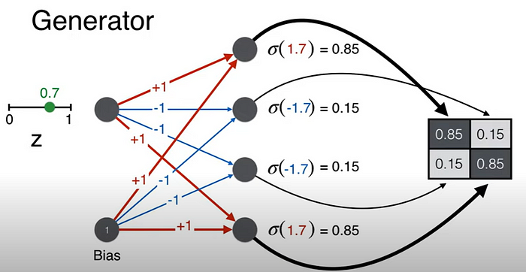
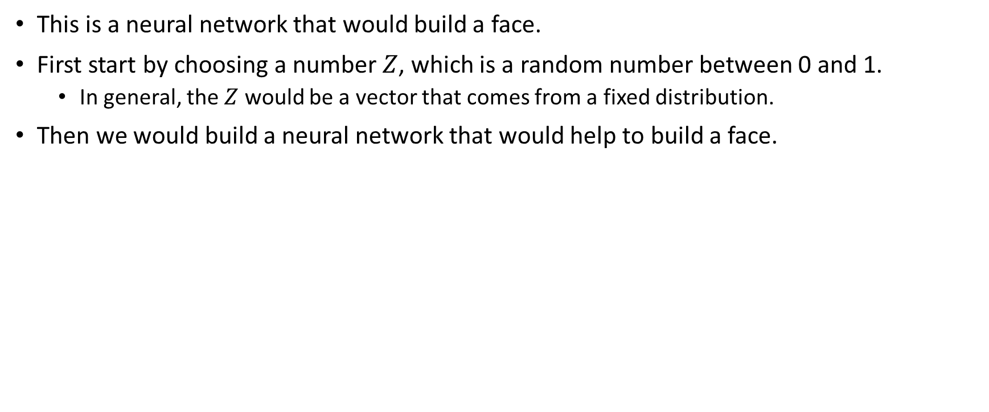
Generative Adversarial Networks: Generator
This is a neural network that would build a face.
First start by choosing a number $Z$, which is a random number between 0 and 1.
In general, the $Z$ would be a vector that comes from a fixed distribution.
Then we would build a neural network that would help to build a face.

Slide 34
Generative Adversarial Networks: Training Steps
In the training process of a GAN, the training typically alternates between two phases:
Train Discriminator (Fix Generator):
During this phase, the generator is fixed, meaning its parameters are not updated.
The discriminator is trained using real and fake data to improve its ability to distinguish between real and generated samples.
The objective is to update the discriminator's parameters to better classify real and fake data, making it more challenging for the generator to fool it.
Train Generator (Fix Discriminator):
In this phase, the discriminator is fixed, and its parameters are not updated.
The generator is trained to generate more realistic data that can fool the fixed discriminator.
The goal is to update the generator's parameters to produce samples that are more difficult for the discriminator to differentiate from real data.
This alternating training process creates an adversarial dynamic between the generator and discriminator, leading to mutual improvement.

Slide 35
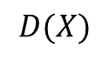
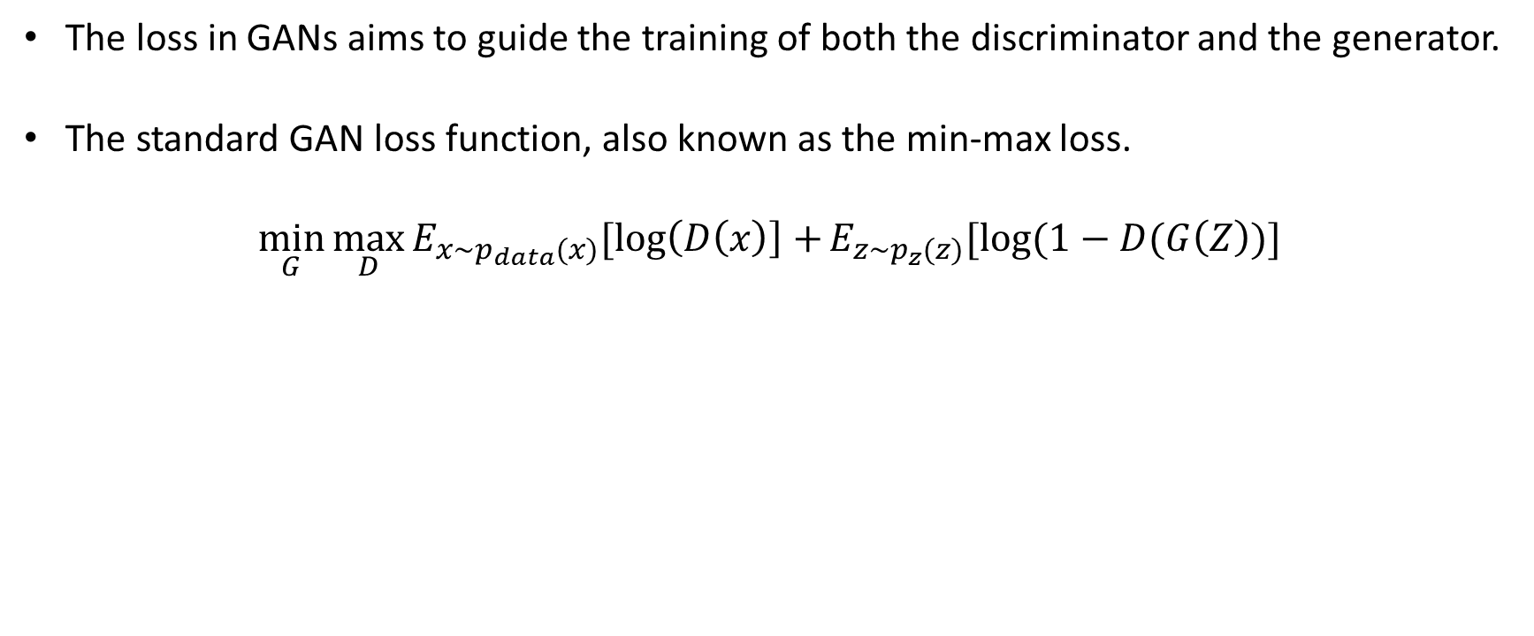
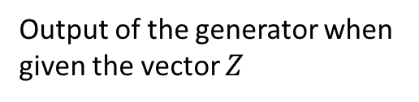
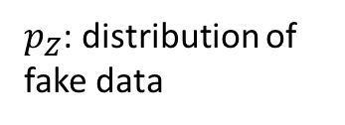
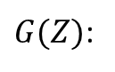
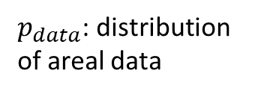
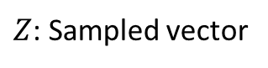
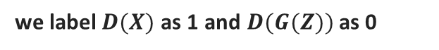
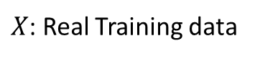
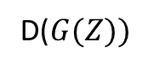
Generative Adversarial Networks: Loss Function
The loss in GANs aims to guide the training of both the discriminator and the generator.
The standard GAN loss function, also known as the min-max loss.
$$\min_{G}{\max_{D}{E_{x\sim p_{data}(x)}[\log\left(D\left(x\right)\right]+}}E_{z\sim p_{z}(z)}[log⁡(1−D(G\left(Z\right))]$$
Generator Net
$G(Z)$:
Output of the generator when given the vector $Z$
$Z$: Sampled vector
Output of the discriminator when given real training data from X.
Discriminator
Net
$$D(X)$$
$p_{Z}$: distribution of fake data
D($G(Z))$
Output of the discriminator when given fake generated data or G(Z).
$X$: Real Training data
we label $D(X)$ as 1 and $D(G(Z))$ as 0
$p_{data}$: distribution of areal data
For real data samples, the discriminator aims to output a probability close to 1 (real), and for fake samples, it aims to output a probability close to 0 (fake).

Slide 36
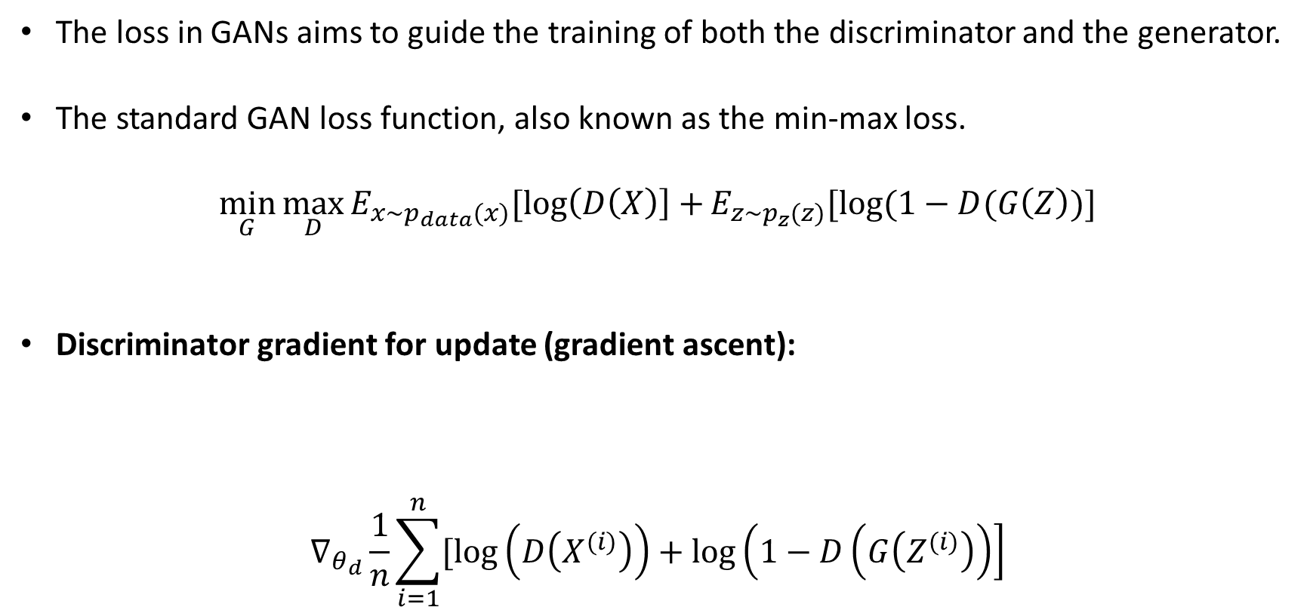
Generative Adversarial Networks: Loss Function
The loss in GANs aims to guide the training of both the discriminator and the generator.
The standard GAN loss function, also known as the min-max loss.
$$\min_{G}{\max_{D}{E_{x\sim p_{data}(x)}[\log\left(D\left(X\right)\right]+}}E_{z\sim p_{z}(z)}[log⁡(1−D(G\left(Z\right))]$$
Discriminator gradient for update (gradient ascent):
$$∇_{θ_{d}}\frac{1}{n}\sum_{i=1}^{n}{[\log\left(D\left(X^{(i)}\right)\right)+\log\left(1−D\left(G\left(Z^{(i)}\right)\right)\right]}$$
predict well on real images
=> want probability close to 1
predict well on fake images
=> want probability close to 0

Slide 37
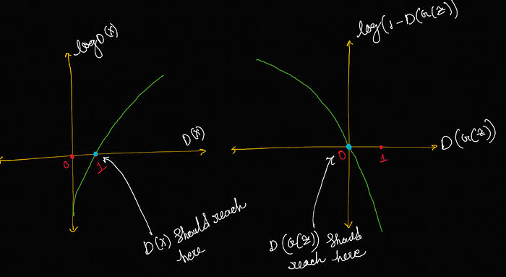
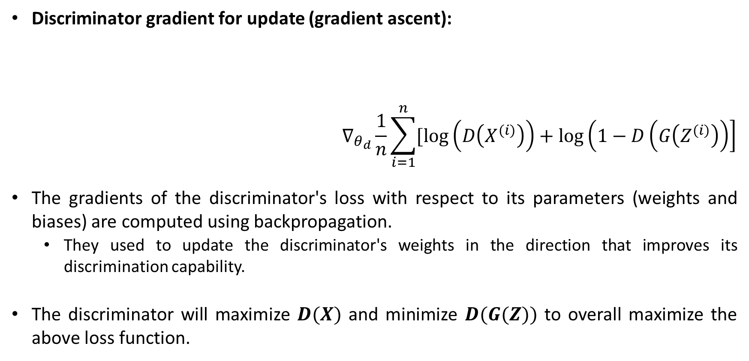
Generative Adversarial Networks: Loss Function
Discriminator gradient for update (gradient ascent):
$$∇_{θ_{d}}\frac{1}{n}\sum_{i=1}^{n}{[\log\left(D\left(X^{(i)}\right)\right)+\log\left(1−D\left(G\left(Z^{(i)}\right)\right)\right]}$$
The gradients of the discriminator's loss with respect to its parameters (weights and biases) are computed using backpropagation.
They used to update the discriminator's weights in the direction that improves its discrimination capability.
The discriminator will maximize $D(X)$ and minimize $D(G(Z))$ to overall maximize the above loss function.
predict well on real images
=> want probability close to 1
predict well on fake images
=> want probability close to 0

Slide 38
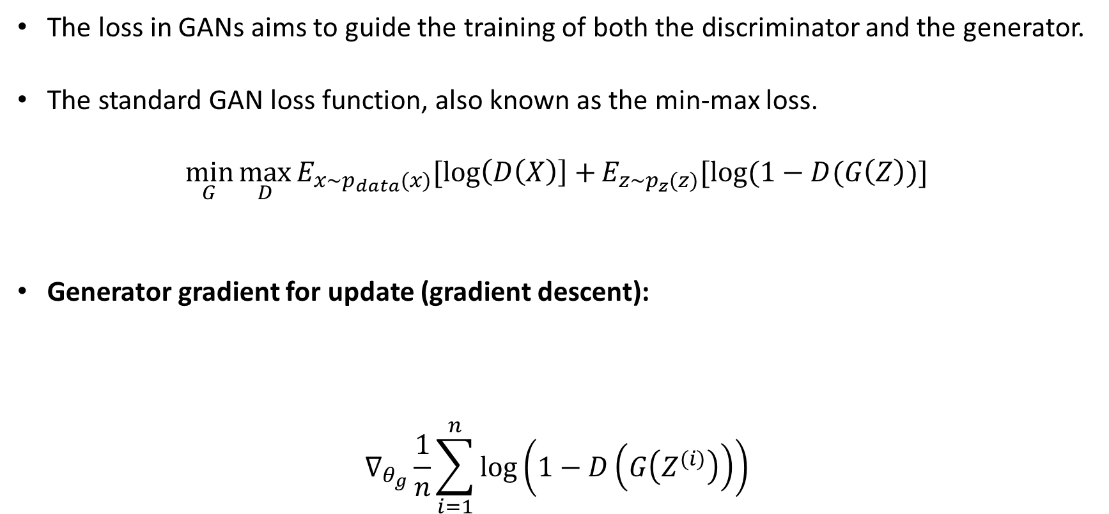
Generative Adversarial Networks: Loss Function
The loss in GANs aims to guide the training of both the discriminator and the generator.
The standard GAN loss function, also known as the min-max loss.
$$\min_{G}{\max_{D}{E_{x\sim p_{data}(x)}[\log\left(D\left(X\right)\right]+}}E_{z\sim p_{z}(z)}[log⁡(1−D(G\left(Z\right))]$$
Generator gradient for update (gradient descent):
$$∇_{θ_{g}}\frac{1}{n}\sum_{i=1}^{n}{\log\left(1−D\left(G\left(Z^{(i)}\right)\right)\right)}$$
predict badly on fake images
=> want probability close to 1

Slide 39

Generative Adversarial Networks: Loss Function
Generator gradient for update (gradient descent):
$$∇_{θ_{g}}\frac{1}{n}\sum_{i=1}^{n}{\log\left(1−D\left(G\left(Z^{(i)}\right)\right)\right)}$$
The generator will minimize the above function and to minimize it the generator must maximize $D(G(Z))$.
Now, it is very clear that the discriminator wants to minimize $D(G(Z))$ and the generator wants to maximize $D(G(Z))$.
predict badly on fake images
=> want probability close to 1

Slide 40
Generative Adversarial Networks
Random Sample

Slide 41

Generative Adversarial Networks: Pseudo-Code
The original GAN paper provides a pseudo-code that shows how a GAN is trained.

Slide 42

Generative Adversarial Networks: Convergence
Converges when Nash-equilibrium (Game Theory concept) is reached in the min max (zero-sum) game.
$$\min_{G}{\max_{D}{E_{x\sim p_{data}(x)}[\log\left(D\left(x\right)\right]+}}E_{z\sim p_{z}(z)}[log⁡(1−D(G\left(Z\right))]$$
Nash-equilibrium in game theory is reached when the actions of one player will not change depending on the opponent's actions.
Here, this means that the GAN produces realistic images and the discriminator outputs random predictions (probabilities close to 0.5).

Slide 43
Challenges in GAN Training
Training Instability:
Issue: GAN training can be highly sensitive to hyperparameters and network architectures, leading to instability.
Impact: Unstable training results in fluctuating losses, poor convergence, or failure to generate realistic samples.
Solutions:
Experiment with different learning rates, batch sizes, and network architectures.
Use regularization techniques like dropout or batch normalization to stabilize training.

Slide 44
Challenges in GAN Training
Non-Convergence or Mode Collapse:
Issue: GAN training may fail to converge or suffer from mode collapse, where the generator focuses on a few modes of the data distribution.
Impact: Non-convergence limits model usefulness, while mode collapse leads to biased or incomplete data generation.
Solutions:
Experiment with different loss functions or regularization methods.
Architectural improvements can also help mitigate these issues.

Slide 45
Challenges in GAN Training
Evaluation and Overfitting:
Issue: Evaluating GAN performance is challenging, and GANs are susceptible to overfitting.
Impact: Overfitting can lead to poor generalization, where the generator only learns to replicate training data without capturing underlying distributions.
Solutions:
Employ cross-validation to monitor generalization during training.
Regularize the GAN model using techniques like weight decay or early stopping.
Objective of Weight Decay (L2 regularization):
The primary goal of weight decay is to penalize large weights in the neural network.
Large weights can lead to complex models that may fit the training data too closely, resulting in overfitting.

Slide 46

Challenges in GAN Training
Vanishing Gradient Problem:
Issue: During training, the gradients may vanish or become extremely small, especially in deep architectures.
Impact: This hinders the learning process, leading to slow convergence or instability in GAN training.
Solutions:
Use techniques like weight normalization or specialized architectures to mitigate gradient vanishing.
Weight Normalization: It can be applied by scaling the weights of each layer to ensure they stay within a reasonable range.

Slide 47

Deep Convolutional GANs (DCGANs)
DCGANs utilize deep convolutional neural networks in both the generator and discriminator architectures.
Convolutional layers are effective in capturing spatial dependencies and hierarchical features in images, making them well-suited for image generation tasks.
For the generator, it typically includes layers like:
deconvolutions,
batch normalization, and
ReLU activation functions.
The discriminator architecture involves:
convolutional layers,
batch normalization, and
LeakyReLU activation functions.

Slide 48

Conditional Generative Adversarial Network
In CGANs, the generator network receives additional conditional information $y$ alongside random noise $Z$ as input.
This conditioning can be in the form of class labels, attribute vectors, or any other relevant information.
The generator learns to generate samples that not only resemble real data but also match the specified conditional information y.
Similarly, the discriminator network in CGANs is conditioned on the same information $y$ during the discrimination process.
It learns to distinguish between real data samples and fake samples while considering the conditional information.

Slide 49


Conditional Generative Adversarial Network
In CGANs, the generator network receives additional conditional information $y$ alongside random noise $Z$ as input.
GAN
CGAN

Slide 50
References
Kuntal Ganguly, Learning Generative Adversarial Networks, Packt, 2017.
Rowel Atienza, Advanced Deep Learning with Keras, Packt, 2018.
Jakub Langr and Vladimir Bok, GANs in Action: Deep learning with Generative Adversarial Networks, Manning, 2019.
David Foster and Karl Friston, Generative Deep Learning: Teaching Machines to Paint, Write, Compose, and Play, O'Reilly, 2019.

Slide 51
Thank you for listening

